Slide 1
story 2
File created on: 10/28/2023 3:23:19 PM

Slide 2
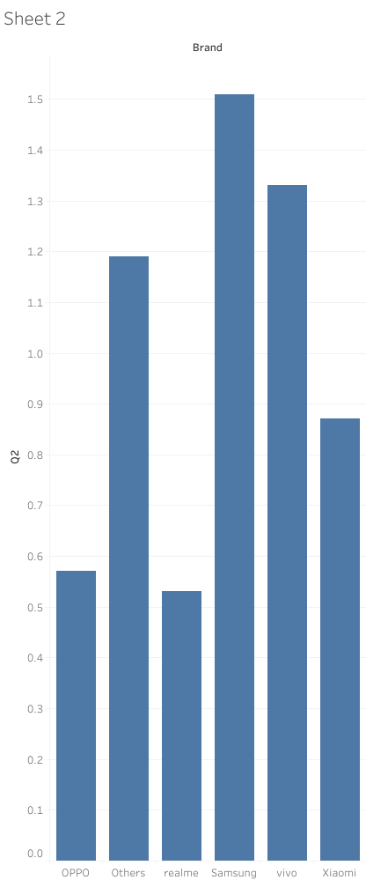

Slide 3
